Slide 1
STEVE REICH – CLAPPING MUSIC
http://www.youtube.com/watch?v=eu-tRXgOrdg&feature=related

Slide 2
For ANY formal presentation:
Please do not be an abuser.
(Apostrophe Abuser, that is!)
This is a really important thing to fix before you start applying for jobs and/or sending notes home to parents and other taxpayers who pay your salary.
If you are a regular abuser get help now.

Slide 3
The mind is not (merely) a vessel to be filled but a fire to be kindled (and stoked).
Plutarch, 44-125 A.D. and DB (21st Century)
(quoted in THE ARTS curriculum and added to by DB)

Slide 4
Imagination can be considered as the power of giving form to human experience
~ as the power of re-describing reality.
Paul Ricoeur

Slide 5
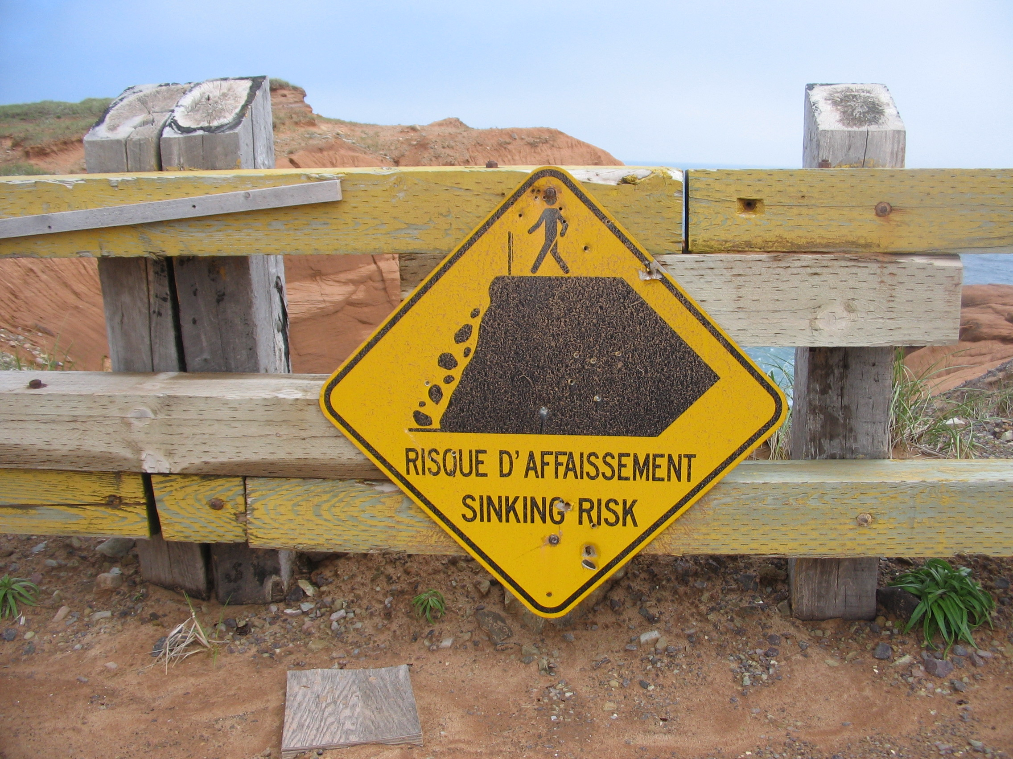
Imaginative teaching is all about living dangerously.
R. Murray Schafer
Notes:
I have lived a bit dangerously in some lesson planning – trying things for the first time. Doing things without always knowing what would happen. Taking risks.
Experience helps with the ability to risk. As you gain experiences, recal how to be risky and edgy.

Slide 6
Imagination is the gateway through which
meanings themselves may be transformed.
John Dewey

Slide 7


Slide 8
By imagining,
we are enabled to look at things,
to think about things as if they
were otherwise.
Maxine Greene

Slide 9
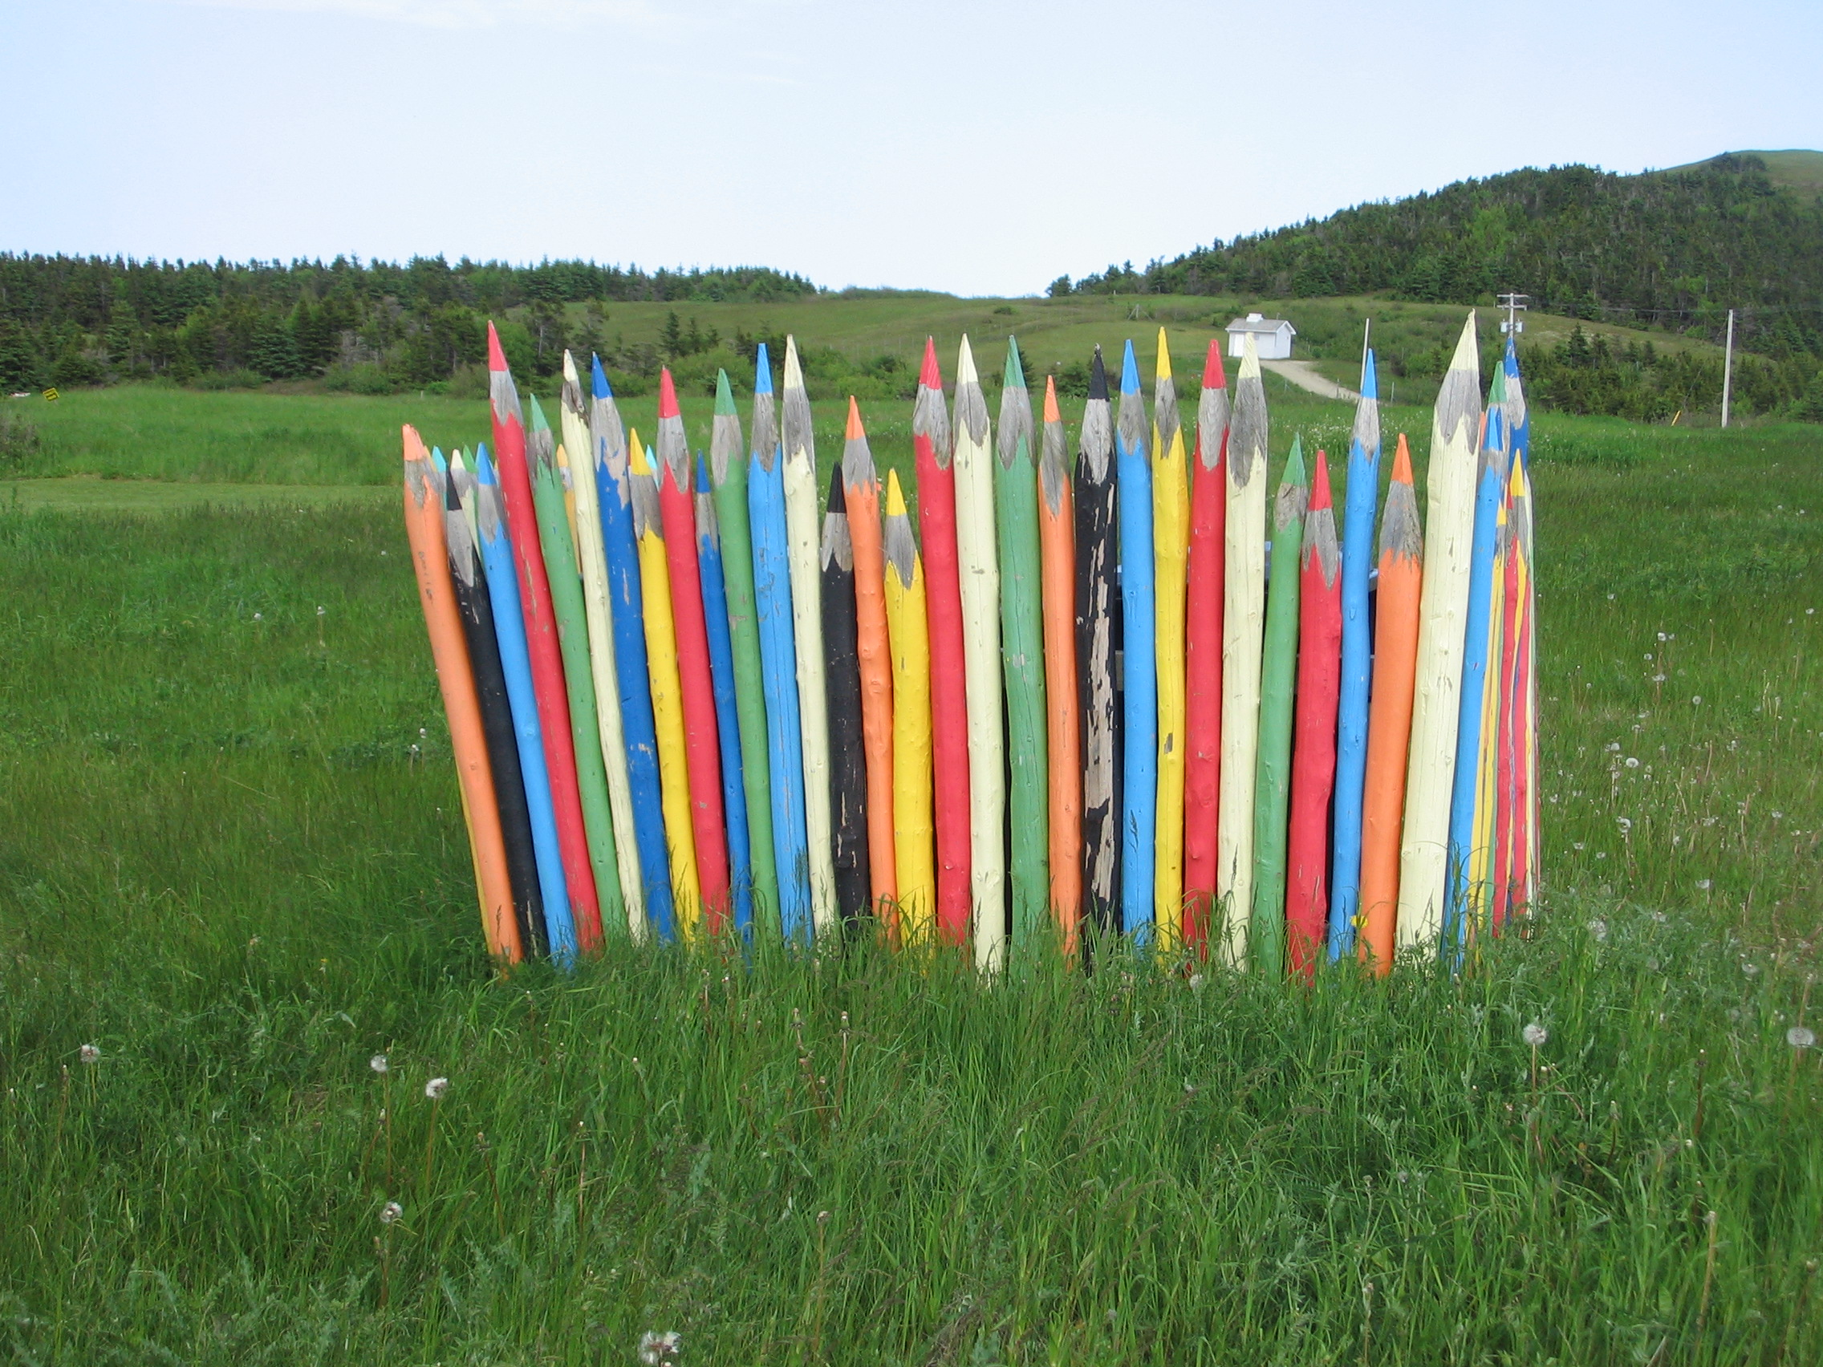

Slide 10
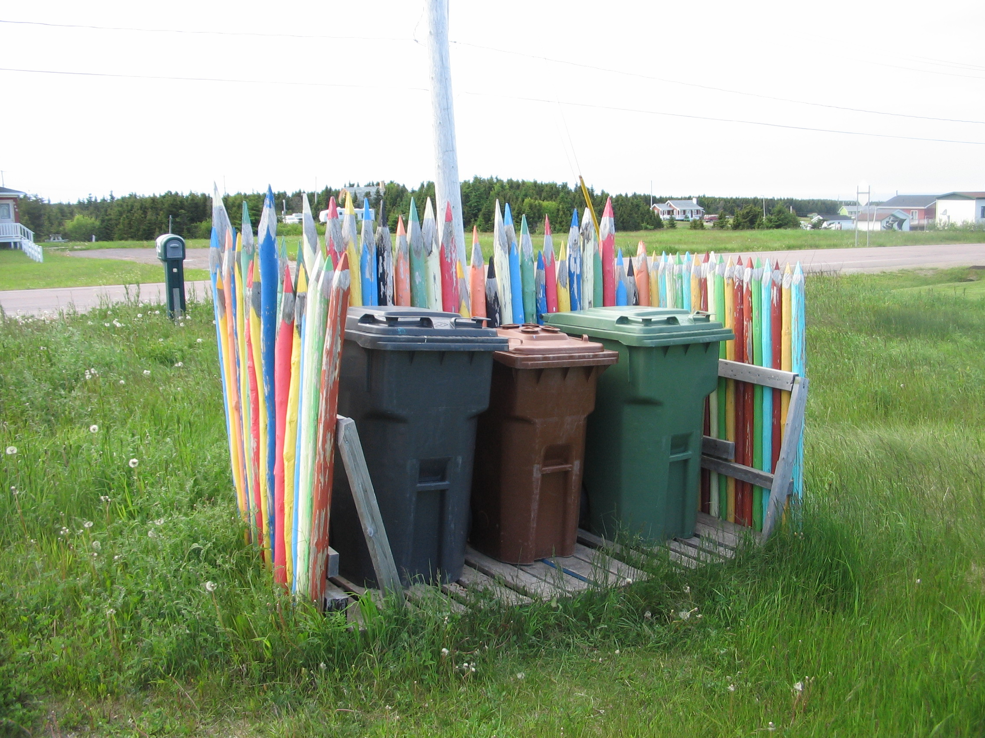
By imagining,
we are enabled to look at things, to think about things as if they were otherwise.

Slide 11
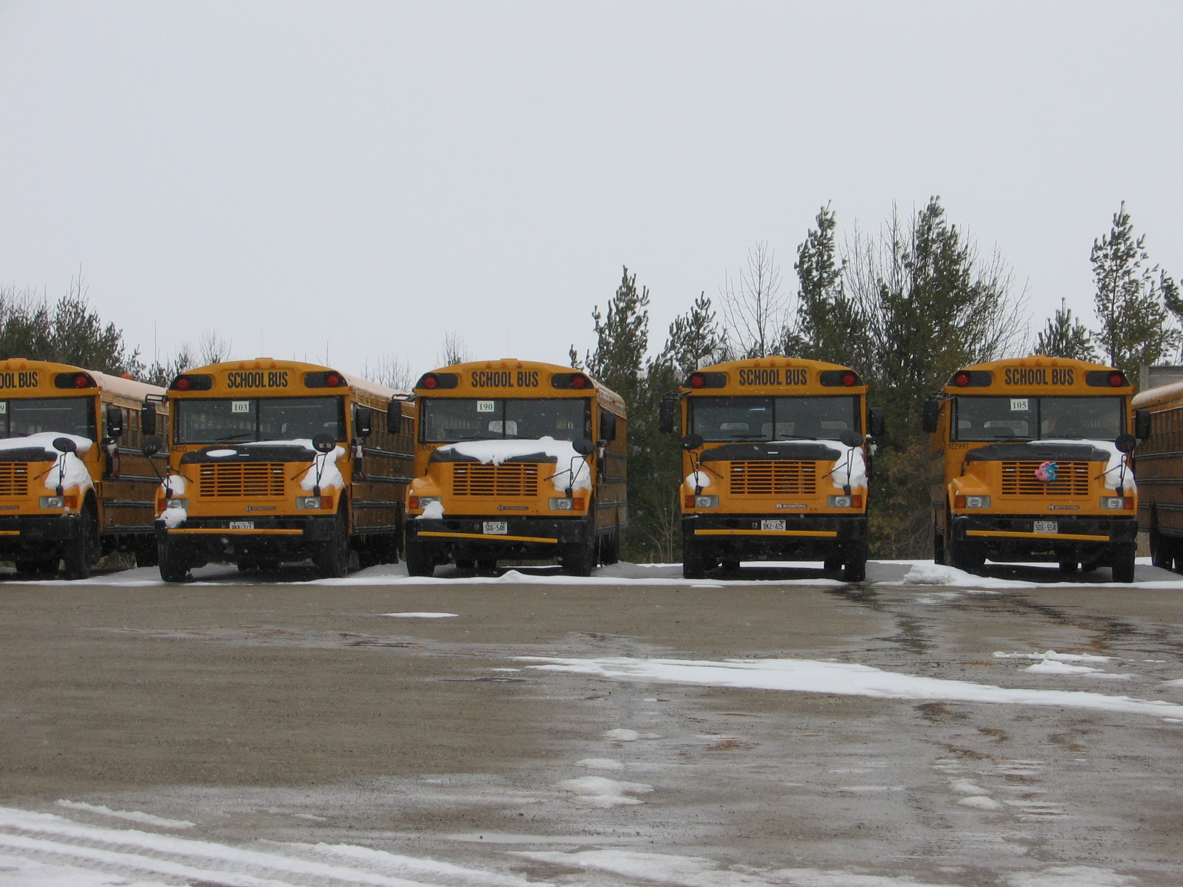
We must teach in a realm infused with
passion and fringed with joy.
Maxine Greene
Notes:
I hope I have offered continuous joy and and passion with what goes on in here.

Slide 12
It can never be just a goal to like or dislike a piece of art or a poem.
The best we can do is involve a stranger in situations of noticing and questioning the unknown.
What might those crows be doing flying over Van Gogh’s wheat field?
Why did that dancer choose to wear that red dress?
Maxine Greene

Slide 13


Slide 14
We have to learn to notice
what there is to notice.
Maxine Greene

Slide 15
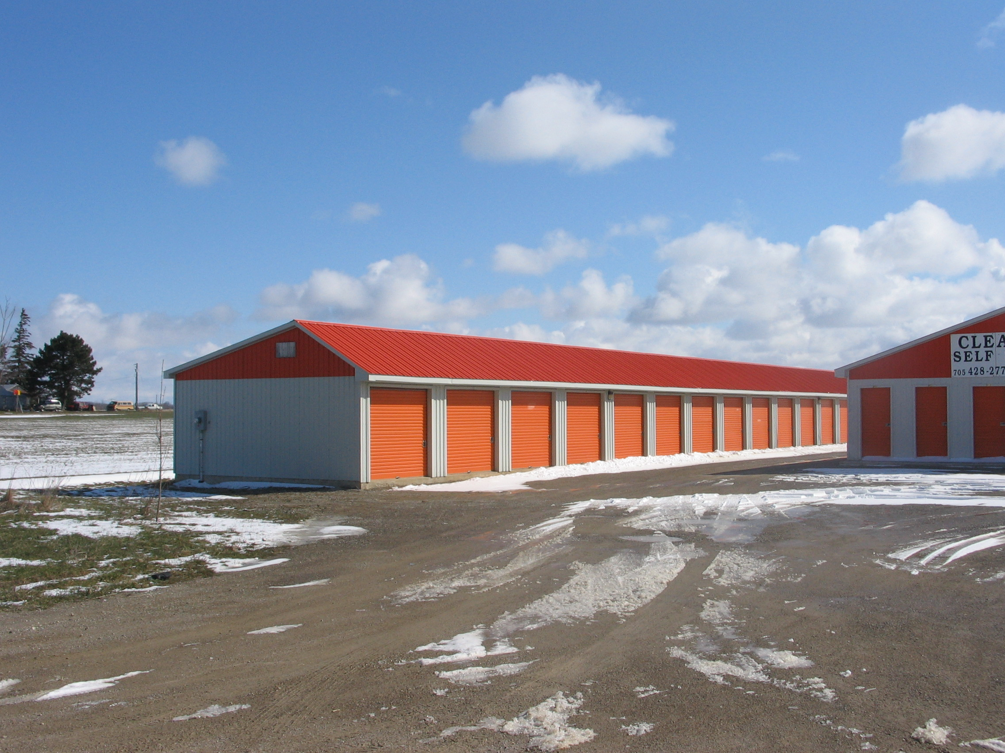
In our educational world of standardized curriculum and tests, imagination work in the classroom has been ignored.
^{Brian Cambourne}

Slide 16


Slide 17
• Please take care with RUBRICS as the only way to assess….
and carefully consider the relationship between ‘expectations’ and contents of rubrics.

Slide 18
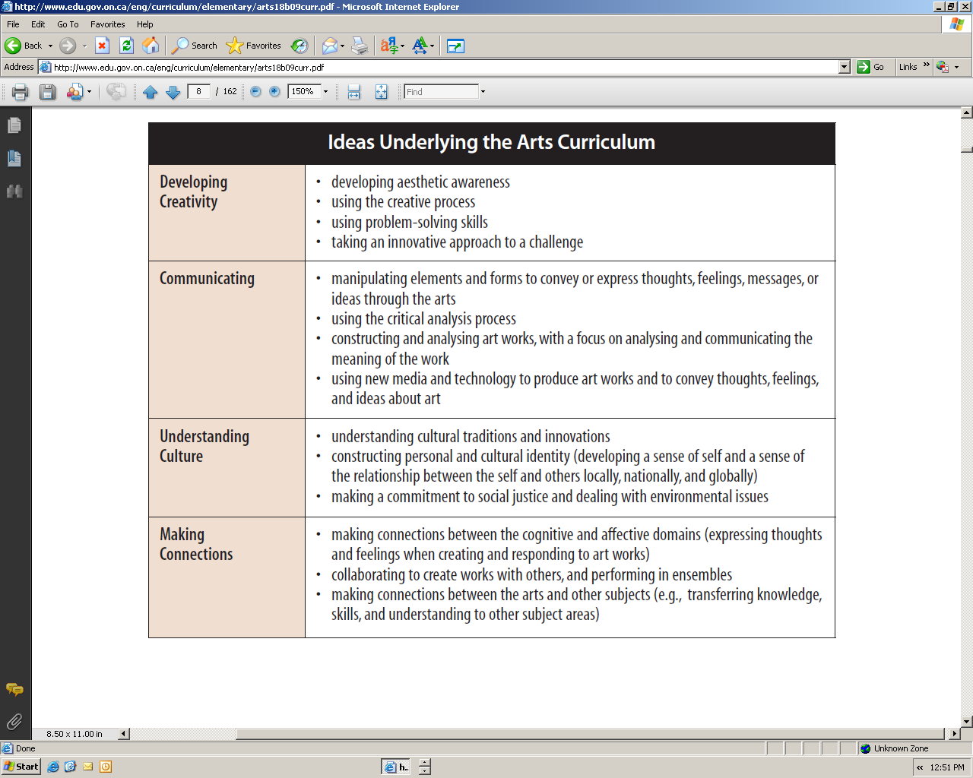
Notes:
Improved alignment with elementary

Slide 19
Some expectations of the MUSIC curriculum can be things that are REALLY complicated to fully comprehend in many ways.
(many of the expectations may be better left to music specialist teachers….singing and playing in tune, for example or analyzing chord patterns, etc.) –
BUT everyone can at least explore aspects of what is there.
Take care about ‘teacher prompts’ – some of them are OK – some inane.
Be ready to be able to answer the question yourself!
And then also be ready for a VERY wide variety of answers. Which are ‘correct’?

Slide 20
• TEACHER PROMPTS: “In emergency, break glass.”
Often the answer that is at first seemingly ‘wrong’ is in effect the most profoundly ‘correct.’
Often the answer that is at first seemingly ‘wrong’
is in effect the most profoundly ‘correct.’

Slide 21
Bloom’s Taxonomy (one form)
Knowledge – IMITATE (list, describe, tell…)
Comprehension – CONFIRM (interpret, outline…)
Application – SHOW (solve, use)
Analysis – DISSECT (distinguish, explain)
Synthesis - INVENT (compose, predict)
Evaluation – JUSTIFY (judge, verify)
CAN THIS Taxonomy BE CYCLICAL?

Slide 22
PLEASE be aware of decibel levels – particularly of music that is typically played at high volume.
Anything over a Db level of 85 is potentially damaging to the hearing apparatus.
I have, for example, experience lots of PhysEd-related music that is well over the 85 Db level.
The music is played as a motivator, I gather, but it is actually causing hearing loss while the participants’ abs are being sculpted.
Once hearing loss has occurred it can never be fixed.

Slide 23
Hearing loss
From: http://www.dangerousdecibels.org/education/information-center/noise-induced-hearing-loss/
“With extended exposure, noises that reach a decibel level of 85 can cause permanent damage to the hair cells in the inner ear, leading to hearing loss. Many common sounds may be louder than you think…
A typical conversation occurs at 60 dB – not loud enough to cause damage.
A bulldozer that is idling (note that this is idling, not actively bulldozing) is loud enough at 85 dB that it can cause permanent damage after only 1 work day (8 hours).
When listening to music on earphones at a standard volume level 5, the sound generated reaches a level of 100 dB, loud enough to cause permanent damage after just 15 minutes per day!
A clap of thunder from a nearby storm (120 dB) or a gunshot (140-190 dB, depending on the weapon), can both cause immediate damage.

Slide 24
How do we become interested in or moved by a song we hear?
Do we simply hear the song and then love it?
Do we not have some sort of prior experience with the emotions and/or mood resident in the song before we become involved in it? (Think about this fully before you answer it…)

Slide 25
Resonance
“Yesterday” has a different intensity of meaning if one has ever had a lover that has been lost, perhaps.
If that is not something already experienced then how can the imagination be engaged to immerse oneself in a place of loss? )
What collective experiences can you create so that a song or musical experience has a better chance of resonating with each student in your class as it is first heard, and then heard repeatedly?
Pick the best ingredients to make the best omelette.

Slide 26
http://www.youtube.com/watch?v=R0jSKJCmeRM&playnext=1&list=PL165D92CB09701EF7 - http://www.youtube.com/watch?v=R0jSKJCmeRM&playnext=1&list=PL165D92CB09701EF7
Who are your heroes?

Slide 27
Say ‘no’ to ‘I don’t think I can….”
http://www.youtube.com/watch?v=ENg-LYqGx6Q&feature=related

Slide 28
You may never know how including the arts in your students’ daily lives may affect them, but PLEASE let the arts live in their lives daily.
http://www.youtube.com/watch?v=-UIjofyfsMw

